Slide 1

LEGALLY DISTINCT creature battler
Dean Bingham
Fred Washington

Slide 2
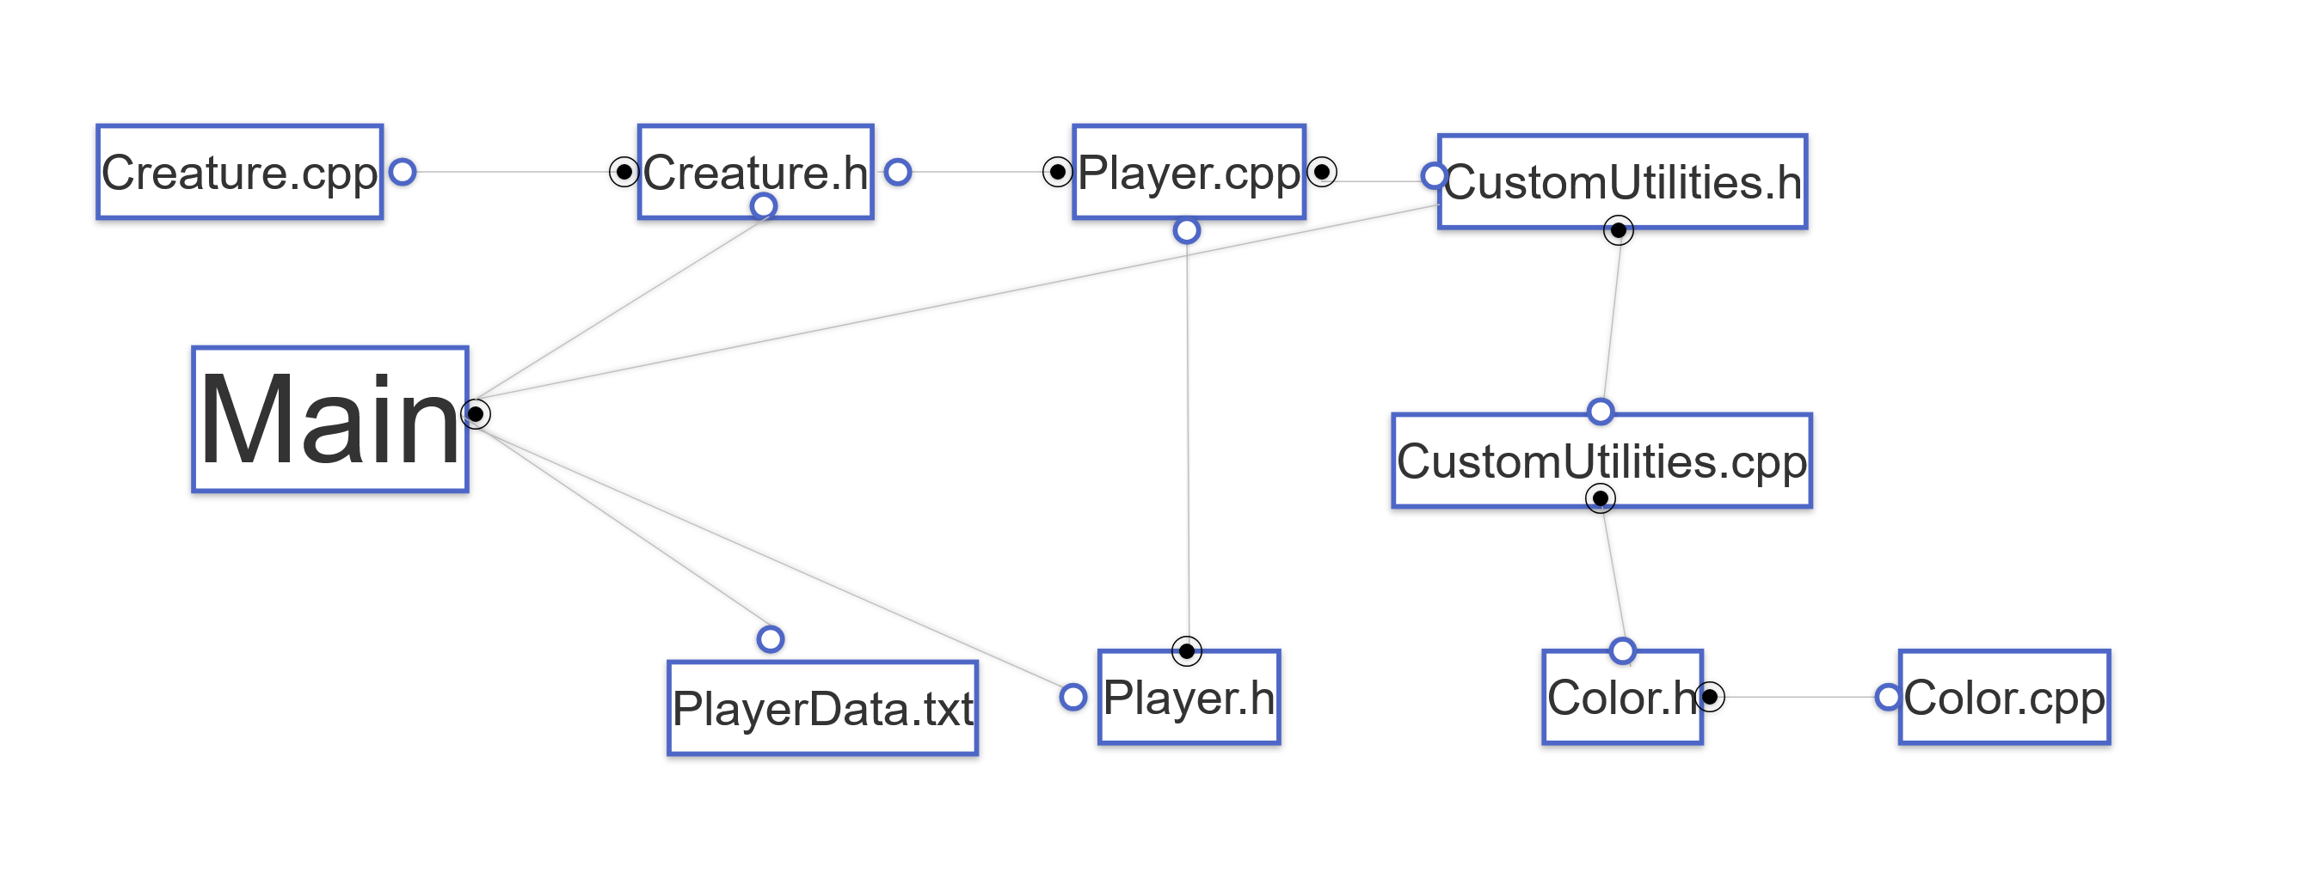
UML Diagram

Slide 3
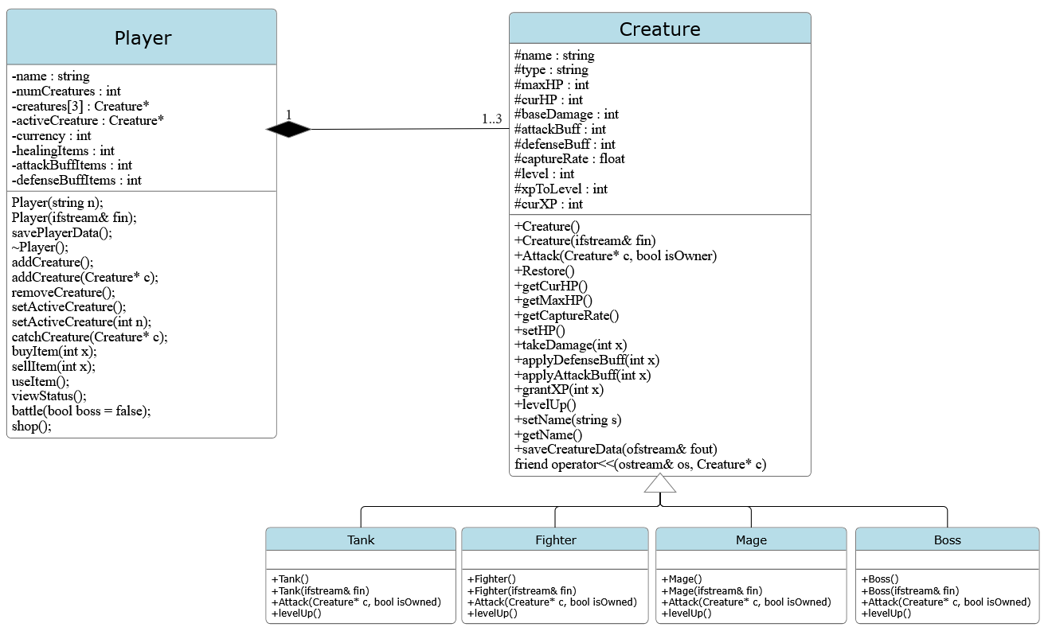
Class Diagram

Slide 4
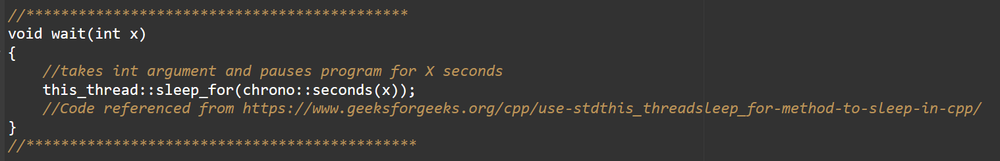
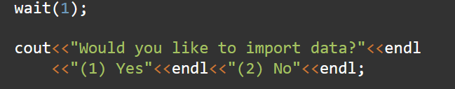
NEW CONCEPTS! Waiting
Wait function allows script to sleep for amount of time in seconds.
  Import Chrono

Slide 5
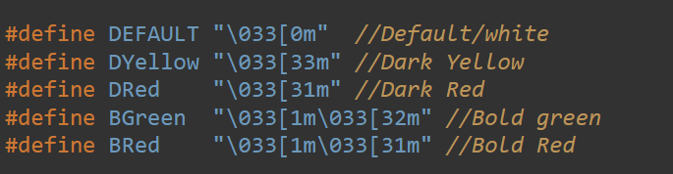
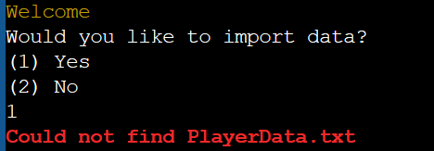
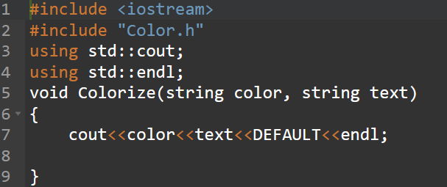
NEW CONCEPTS! Colors
Color function allows changing colors. You can adjust hue as well as background color or bold fonts.
  Define colors

Slide 6
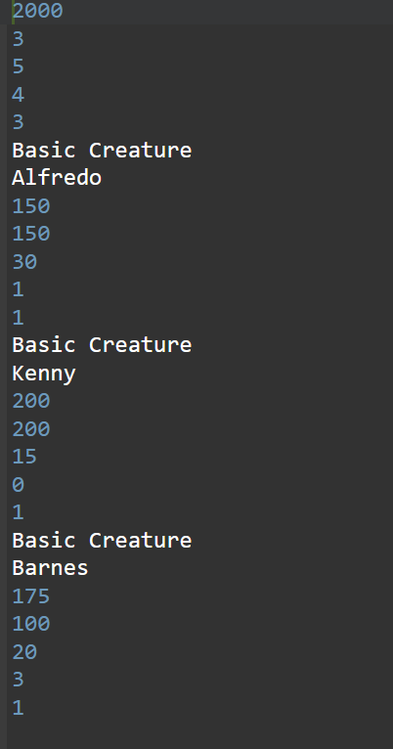
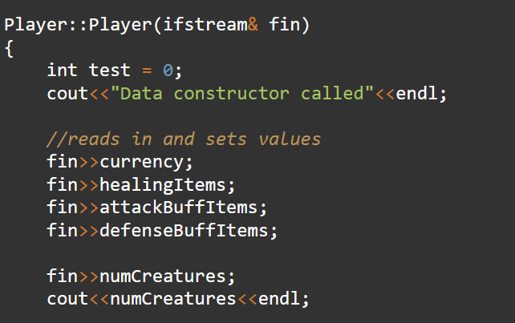
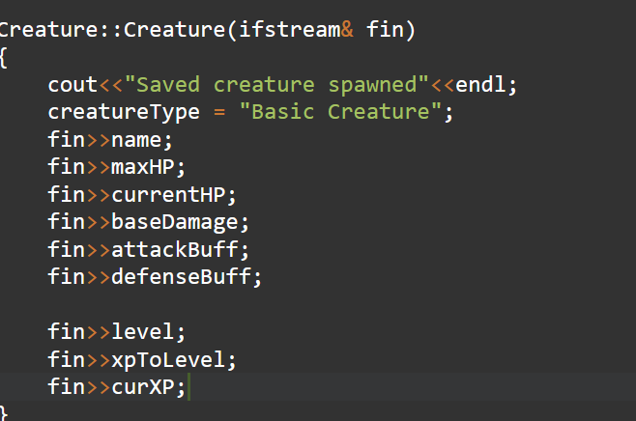
Player Saving
PlayerData.txt
Player can export their gamefile to player save file. When opening the game again, they can import data from player data file and continue where they left off.
Also allows for modification of player data
<-Overloaded
Constructor in
Player.cpp.
Calls similar
Constructor for
Each creature

Slide 7
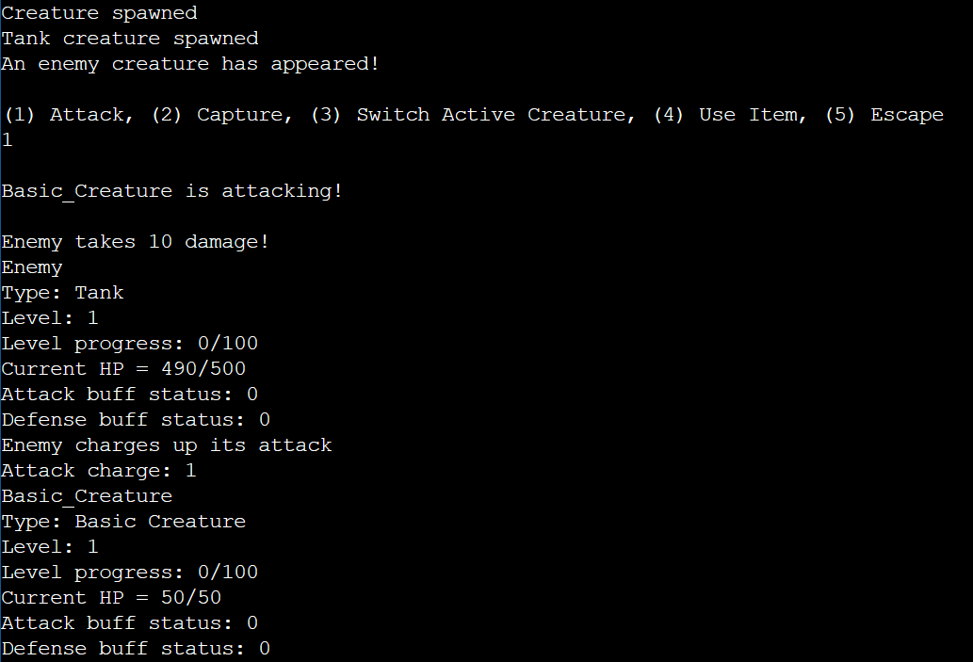
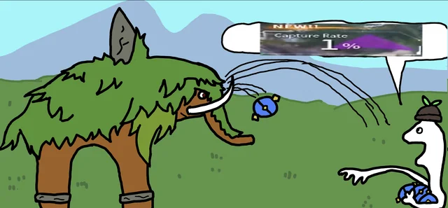
Battles
Game spawns randomized enemy
Player chooses option
Player can attack enemies to do damage. Enemies with less health are more likely to be captured.
Some creatures can alter the stats of other creatures
Player can fight and beat the boss to win the game

Slide 8

Now for a demonstration

